Slide 1
Signaling Power & Signaling to Power
Twitter and Tear Gas
By:
Shubham Mishra
IST 445H
Notes:
Good afternoon everyone, I am Shubham Mishra and, today we will be moving to the next part of the book “twitter and tear gas”, which is part 3: after the protests.
This is chapter 8th of the book, which is Signaling Power and Signaling to Power.

Slide 2

Overview
Start of Part 3 of the book “Twitter and Tear Gas” by the author. The name of the part 3 of this book is “After the Protests”.
Talks about how different protests in a movement depends on the interactions and signals of capacity between those in power and those who seek to challenge that power of greater authority.
Examines and analyses the impact of digital technology in various case studies in this chapter and how it has affected the result of the movement as an aftermath.
Notes:
So, here’s an overview of this presentation and discussion; in this chapter, the author talks about how a social movement is affected by signals of capacity and how the people in greater power retaliate and how in return, the protesters retaliate by challenging the power of greater authority. The author also analyses how digital technology has affected different social movements over all these years and what was the result of using it in the society.

Slide 3
What is Capacity?
This term comes from the field of human development.
It basically means evaluating the movement’s collective ability to bring social change rather than measuring available benchmarks.
The author uses the word “capacity” several times in this book
The word ”CAPACITY” in social movements demonstrate the protest in different scenarios:
1. What did it take to organize the protest?
2. What was the threat the social movement organization faced?
3. Was the protest a one-time gathering or a recurrent meeting of a group of people?
Notes:
So let’s talk about the term “capacity”, this term has been mentioned several times in this particular chapter. Capacity is a term used in the field of human development; it basically means determining the protester’s ability as a whole group to bring change in the society.
This term is used in social movements to demonstrate the protest in different scenarios:
1. What did it take to organize the protest?
2. What was the threat the social movement organization faced?
3. Was the protest a one-time gathering or a recurrent meeting of a group of people?

Slide 4
Summary
Antiwar March in February 2003
It was a massive global wave of movements opposing the war in Iraq, Guinness World Records named it as the largest antiwar rally in the history as around 600 cities in the whole world participated in a series of protests.
The antiwar movement was large, energetic and had heavy participation.
How to measure a protest's power?
How social movements build and SIGNAL capacity to those in power?
Strength of social movements include: setting the narrative, to affect electoral or institutional changes and to disrupt the status quo.
3 CRUCIAL CAPIBILITIES OF SOCIAL MOVEMENTS:
1. Narrative Capacity
2. Disruptive Capacity
3. Electoral and/or Institutional Capacity
Notes:
So now we will talk about the summary of this chapter. At the start of the chapter, the author talks about the antiwar march is February 2003, when there was an enormous global wave of movements opposing the war in Iraq. In this series of social movements, around 600 cities from the whole world participated in this protest and hence the Guinness World Records named this march as the largest antiwar rally in the history. Approximately 9 million people took part in this antiwar rally.
This movement was large , energetic and heavy participation.
Now lets talk about how do we measure a protests power?
- Narrative Capacity refers to the ability of the movement to frame its story on its own terms and to spread its worldview.
Disruptive Capacity describes whether a movement can interrupt the regular operations of a system of authority.
Electoral or Institutional capacity refers to a movement’s ability to keep politicians from being elected, reelected or nominated unless they adapt and implement policies friendly to the social movement’s agenda.

Slide 5
Continued
How to make a social movement successful? (according to the author)
The social movements should convince that the issues are important.
Their stance and demands are legitimate
To persuade people to not just make the outside people join the cause but to persuade people inside the movement to undertake the initial and often painstaking work of early movement formation.
Changing the minds of elites and those in law enforcement is important because in a more repressive society, the movements might face heavy violent retaliations.
Notes:
In this chapter, the author also gives some solutions and suggestions as to how a social movement can become successful:
The social movements should convince that the issues are important.
Their stance and demands are legitimate
To persuade people to not just make the outside people join the cause but to persuade people inside the movement to undertake the initial and often painstaking work of early movement formation.
Changing the minds of elites and those in law enforcement is important because in a more repressive society, the movements might face heavy violent retaliations.

Slide 6
Continued
Mainstream Views
It is the way in which a movement can find itself cut out from the newsletters if the journalists don’t believe that the issue is news or is even worth covering because the journalists have adopted the dominant framework.
Hence, as movements are struggling for favorable media coverage, with the use of digital tools, protesters are increasingly turning to make their own media.
How to get attention of the public for a movement to take place successfully?
Narrative capacity is used as a movement’s capacity to get attention and to appeal on its own terms to the broader public for redress of its grievances. It allows the movement’s ability to demonstrate a voice, get its voice heard and have it responded to as legitimate.
Notes:
The author mentions about mainstream views and how it can affect a social movement’s pace. Mainstream views is the act in which a movement can find itself cut out from the newsletters if the journalists don’t believe that the issue is news or if it is even worth covering because the journalists have adopted the dominant framework.
Since protesters are cut off from the mass media productions in the form of journalism, here comes the use of digital tools, where protesters try and make their own media and allow the social movements to grow.
Now lets talk about narrative capacity and how it can be used in a movement to gain attention of the public and appeal on its own terms to make their voice heard. Narrative capacity here will allow the movement’s ability to articulate a voice.

Slide 7
Social Movements and Democratic Societies
In several democratic societies in various countries, powerful groups (in terms of monetary) have controlled electoral politics by control of media to elect preferred candidates.
Hence, the responsiveness of electoral politics of the desires of citizens have dropped in many countries as there is a trend for people to become wary of representative democracy as a solution to social problems because citizens have seen it fail repeatedly.
This is an example of Electoral Threat:- In the US, programs like Medicare ( a service which provides health care facilities for the elderly people are generously funded, however, higher education; a service which benefits younger people suffers from deep funding cuts. This is happening because politicians know that the elderly people are more likely to vote than younger people and young people are less likely to act as an interest group via social movements to carry electoral threats.
Notes:
Moving on, now let’s talk about how big, strong and powerful monetary groups have controlled politics and used mass media to elect preferred candidates. Hence, we arrive here to the discuss the relationship between social movements and democratic societies.
Since money is used to strong electoral politics, the desires of citizens have dropped in several countries as people have become wary of representative democracy as a solution to social problems because over the past decades, citizens have seen it fail so many times.
Now let’s talk about an example of electoral threat:
In the US, programs like Medicare ( a service which provides health care facilities for the elderly people are generously funded, however, higher education; a service which benefits younger people suffers from deep funding cuts. This is happening because politicians know that the elderly people are more likely to vote than younger people and young people are less likely to act as an interest group via social movements to carry electoral threats.

Slide 8
Disruptive Capacity In Detail
Protests SIGNAL disruptive capacity when they interrupt businesses as usual, this type of interruption may happen in the form of a momentary intervention.
Disruptive acts can take place for various years or decades, for example, Mahatma Gandhi, the leader of the Indian Independence movement, led India to a multiyear strategy of noncooperation with the British Empire.
Disruptive tactics do not always receive positive media coverage because risk angering people as most of the times disruptive tactics are regarded as illegitimate, counterproductive and needlessly burdensome or violet. They also run the risk of overexposure because the tactics themselves attract a lot of media attention which may eclipse the issues the movement wants to discuss.
Notes:
What is disruptive capacity in detail? It is a movement’s ability to interrupt businesses as usual with the aim of getting attention, making a point, or making it untenable for those in power to continue as in the past, and to sustain such disruption over time. Disruptive capacity is powerful but also carries the highest risk of backlash.

Slide 9
Egyptian Evolution and Technology
Author talks about 2 groups of people of the Egyptian Revolution in 2011 in Tahrir Square: 1: A group of few thousand people, 2: Hundreds of people who were almost always present
Protestors in 2011 opened a Facebook page that reached millions of Egyptians and hundreds of thousands of people replied “Yes” to this Facebook page’s electronic invitation to the revolution, hence it was a Public Signal.
The few thousands of people in 2011 were able to set off a chain of events that those in power were inclined to interpret as signaling real capacity that required an effective response.
People were blogging, texting in internet and tweeting via the internet for years for this movement. The protest grew and since Tahrir Square in one of the most important squares in Cairo, this made it difficult for the government to keep the city operating smoothy and it’s a good example of both narrative and disruptive capacity.
Notes:
Use of both communication and digital technologies as a form of organization. Digital tools have greatly affected movements like this by strengthening, altering or even weaking some of their capacities. They also affect the movement choices and readiness and lead to a variety of outcomes, especially when they are coupled with the cultural and political choices of social movements. Moreover, digital tools greatly enhance narrative capacity.

Slide 10
#BlackLivesMatter and Technology
#BlacklivesMatter was a movement which emerged primarily through a network that uses social media both to organize and communicate and as a tool for gathering attention and shaping narratives; this network was able to overcome challenges and successfully developed narrative capacity without tools that older movements used like formal organizations and leaders.
With the evolution of use of technology for social movements, there has been a great shift in the amount of attention paid to these killings.
In many of the protests for #BlacklivesMatter, several journalists and residents started tweeting images showing the massive police force that had been arrayed against the protestors. People all over the country were tweeting.
Analysis showed that there were around 3 million tweets related to #Ferguson.
Notes:
In August 2014, a black teenager Michael Brown was killed by a police officer in Ferguson, Missouri. Witnesses claimed that his hands were up in the air when he was shot, there was no video of the incident. His body was left in the middle of the street in the hot month of August for many hours. Hence, there was a peaceful protest however, armored vehicles with snipers on top of them, held rifles aimed at the residents which seemed a bit too much. Therefore, the conversation on twitter became extremely loud. This chain of events in Ferguson propelled the topic to national attention. The good outcome from this movement was that the political scene started changing; politicians felt pressure to discuss reforms of the criminal justice systems and the differential manner of policing applied to communities of color. Hence, the Justice Department opened inquiries into some of these killings. Because of this movement, polls began shifting. In conclusion to this case study, #blacklivesmatter exhibited great narrative capacity.

Slide 11
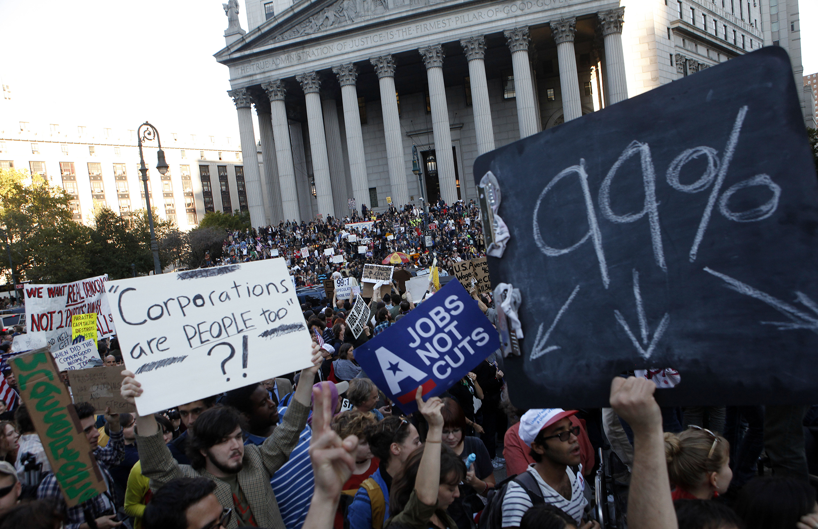
Occupy Movement and Technology
In June 2011, Adbusters, a Canadian anticonsumerist magazine sent an email to its subscribers “America needs its own Tahrir”. This allowed a global movement to be founded and this movement was known as the “Occupy Movement”.
It was an inspired movement with uprisings in Middle East. This movement led to a movement in New York and there were protests in eighty countries and almost a thousand cities and this movement involved millions of people. The main slogan for this movement was for “We are the 99 percent”.
In the first month of the movement, researchers identified almost 400 Facebook pages dedicated to it and hundreds of thousands of people participated in those pages.

Slide 12
Criticism of the Reading
The author says that technology has increased participation of protesters in several movements as described before.
However, because of increased participation, there has been increased violation and crimes which has also led to an increase of mortality rate and there is increased damage of municipal and state properties.
Many people don’t take the time to research the facts and come across social media posts or retweet something without fact-checking it.
For example in the Occupy Movement, instead of creating a list of plans for the movement as a whole, the members gathered every night in a meeting called “General Assembly” where they voiced all of their individual concerns.

Slide 13
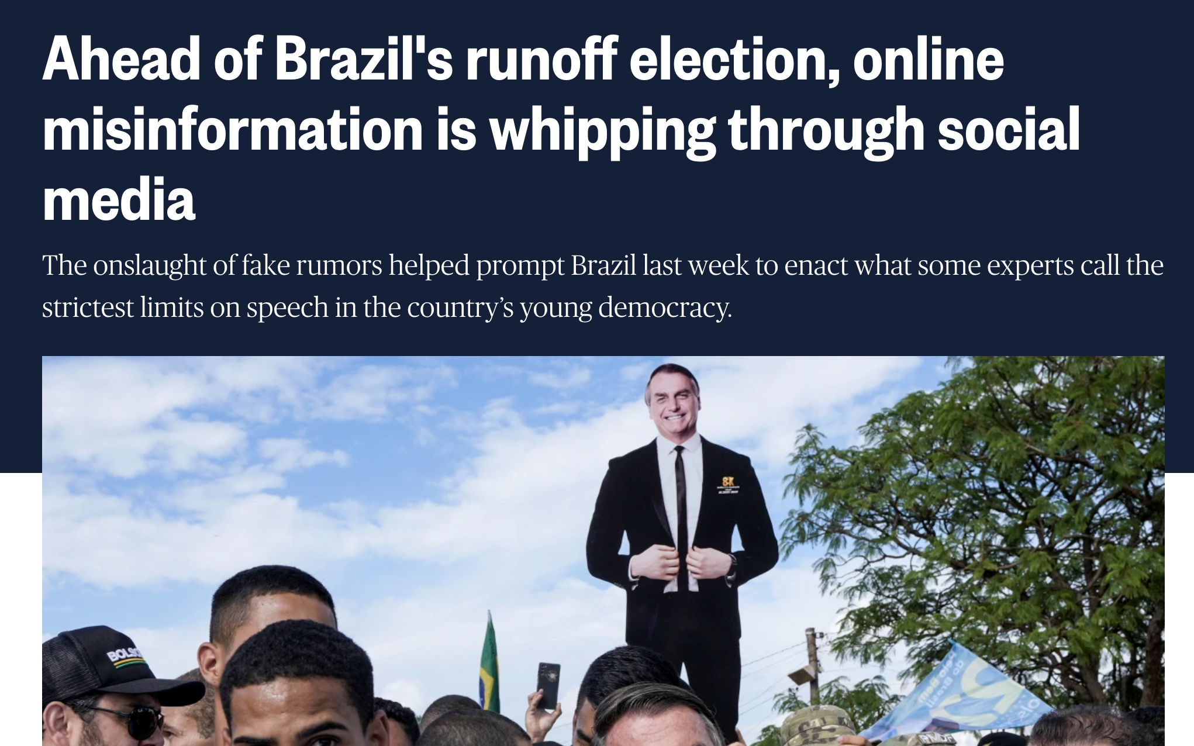
Current Event: Brazil’s Runoff Election and Misinformation
Brazilian voters are being bombarded by online misinformation less than a week before they pick their next leader.
The false rumors are that:
1. The leftist candidate in Brazil’s presidential election plans to close down churches if elected.
2. Falsely alleging that the right-wing President Jair Bolsonaro has made comments confessing to cannibalism.
The campaign director of US based activist group said that “What is happening in Brazil on Facebook and Twitter looks awfully similar to what was happening in the US around the 2020 election.
Notes:
Although the potential to transform society is real, sometimes the impact of online activism is negative for society. For instance, terrorist groups are also using online activism to achieve their goals.

Slide 14
Questions to Class
How to make sure all of the people in social media are aware of the issue being raised in a movement and make sure that there is no scope of misinformation or lies?
How to prevent terrorist groups from using online activism to achieve their goals?

